Slide 1
The Impact of Machine Learning
AI Boot Camp
Module 1 Day 2
© 2023 edX Boot Camps LLC. Confidential and Proprietary. All Rights Reserved.
Notes:
Brief overview of what students will learn in this class.

Slide 2

Class Objectives
By the end of class, you will be able to:
1
Compare and contrast supervised and unsupervised ML.
2
Define complex AI models including neural networks, deep learning, natural language processing, and transformers.
3
Download and upload files to GitHub using the git GUI.
4
Add, commit, and push code to GitHub from the command line.

Slide 3

Instructor Demonstration
Demystifying Machine Learning
Notes:
Learning Outcomes:
Understand the concept of pseudocoding
Source Material:
Coding prework: adapt content from Practice Computational Thinking section - some of this should be presented in a slideshow, and some of it could be presented by the instructor in VS Code.
Additional details:
The pseudocode provided in the source material uses JavaScript commenting style (double slashes //); we’re using Python for this course so the commenting style should use # instead.

Slide 4


Remember,
Machine learning (ML) is the practice of applying computer algorithms and statistics to create models that can learn from data, and then make decisions or predictions about future data.
ML algorithms learn how to make decisions without needing anyone to program all that logic. They learn the patterns, behavior, and logic on their own directly from the data, and then use that knowledge to make decisions and predictions.

Slide 5
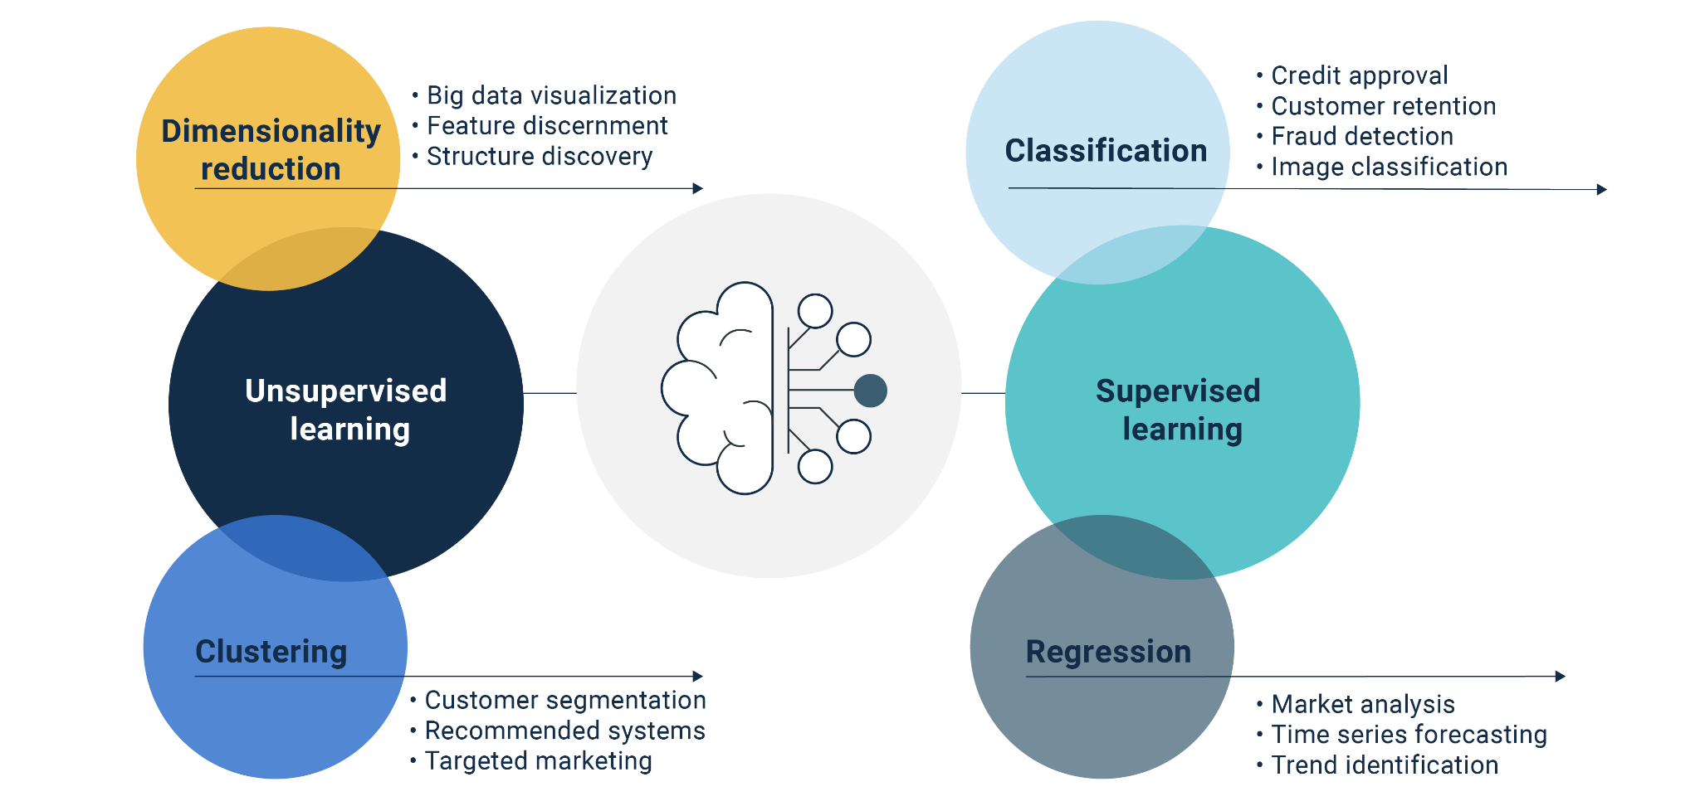
Types of Machine Learning

Slide 6
Types of Machine Learning
Supervised Learning | Unsupervised Learning
Trained with labeled data | Trained with unlabeled data
Finds relationships that help in predicting the labels in the training data | Finds relationships in the data that help distinguish data points more generally
Uses those relationships to predict which labels new points should have | Uses those relationships to add context that can assist in further analysis

Slide 7
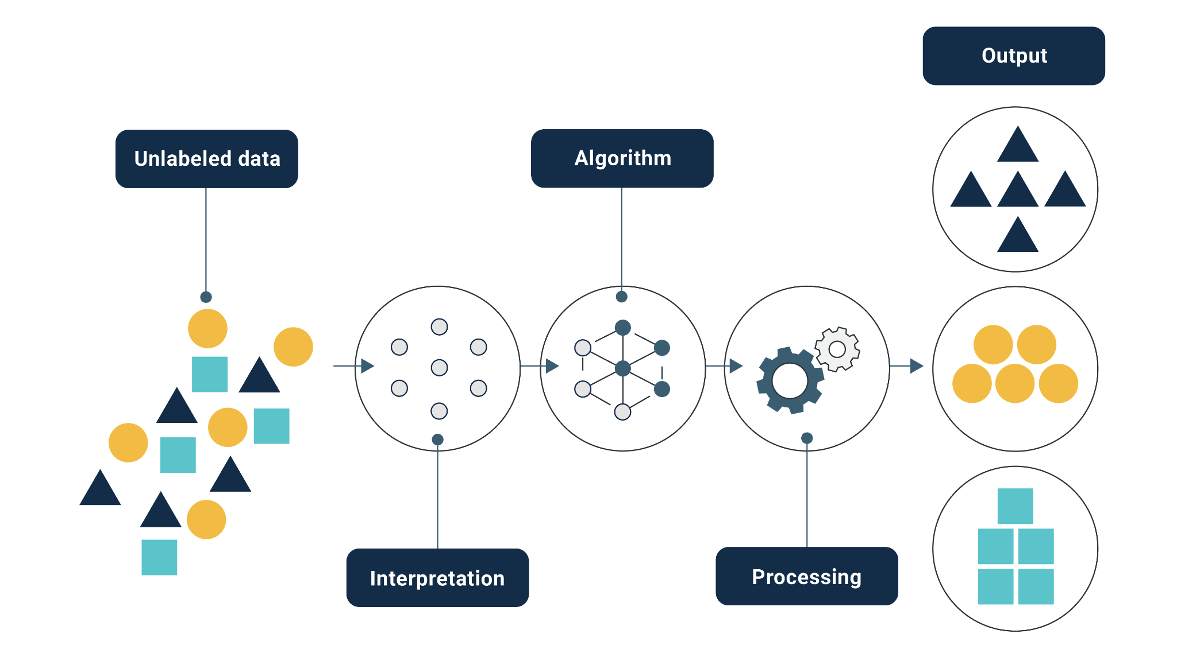
Unsupervised Learning

Slide 8
Applications of Unsupervised Learning
Exploratory data analysis
Cross-selling tactics
Consumer segmentation
Pattern recognition

Slide 9
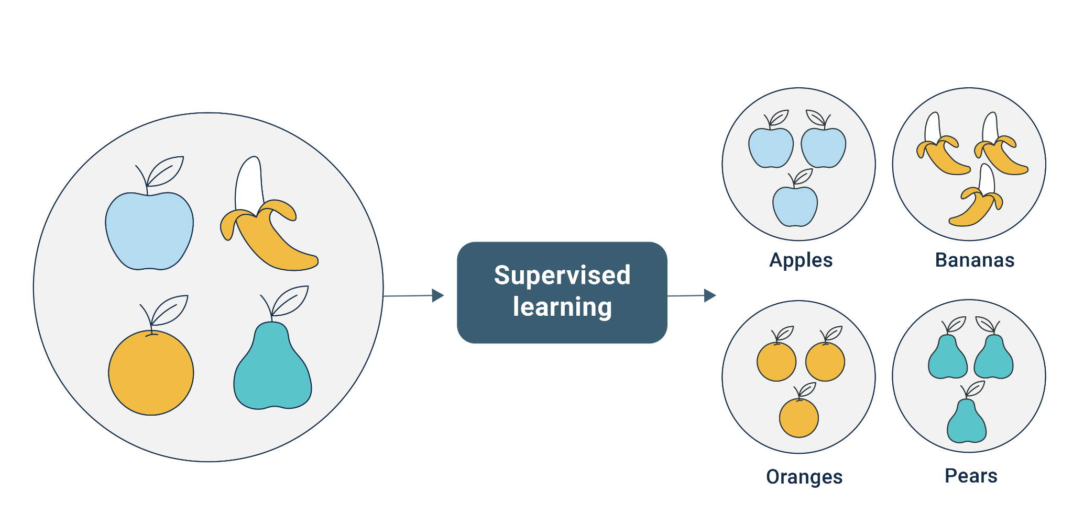
Supervised Learning

Slide 10
Instructor Demonstration
Advanced Technologies
Notes:
Learning Outcomes:
Understand the concept of pseudocoding
Source Material:
Coding prework: adapt content from Practice Computational Thinking section - some of this should be presented in a slideshow, and some of it could be presented by the instructor in VS Code.
Additional details:
The pseudocode provided in the source material uses JavaScript commenting style (double slashes //); we’re using Python for this course so the commenting style should use # instead.

Slide 11
Neural networks are a set of algorithms that are modeled after the human brain. Neural networks are designed to mimic the way our brains function, with artificial neutrons serving the same purpose as our biological neurons.

Slide 12
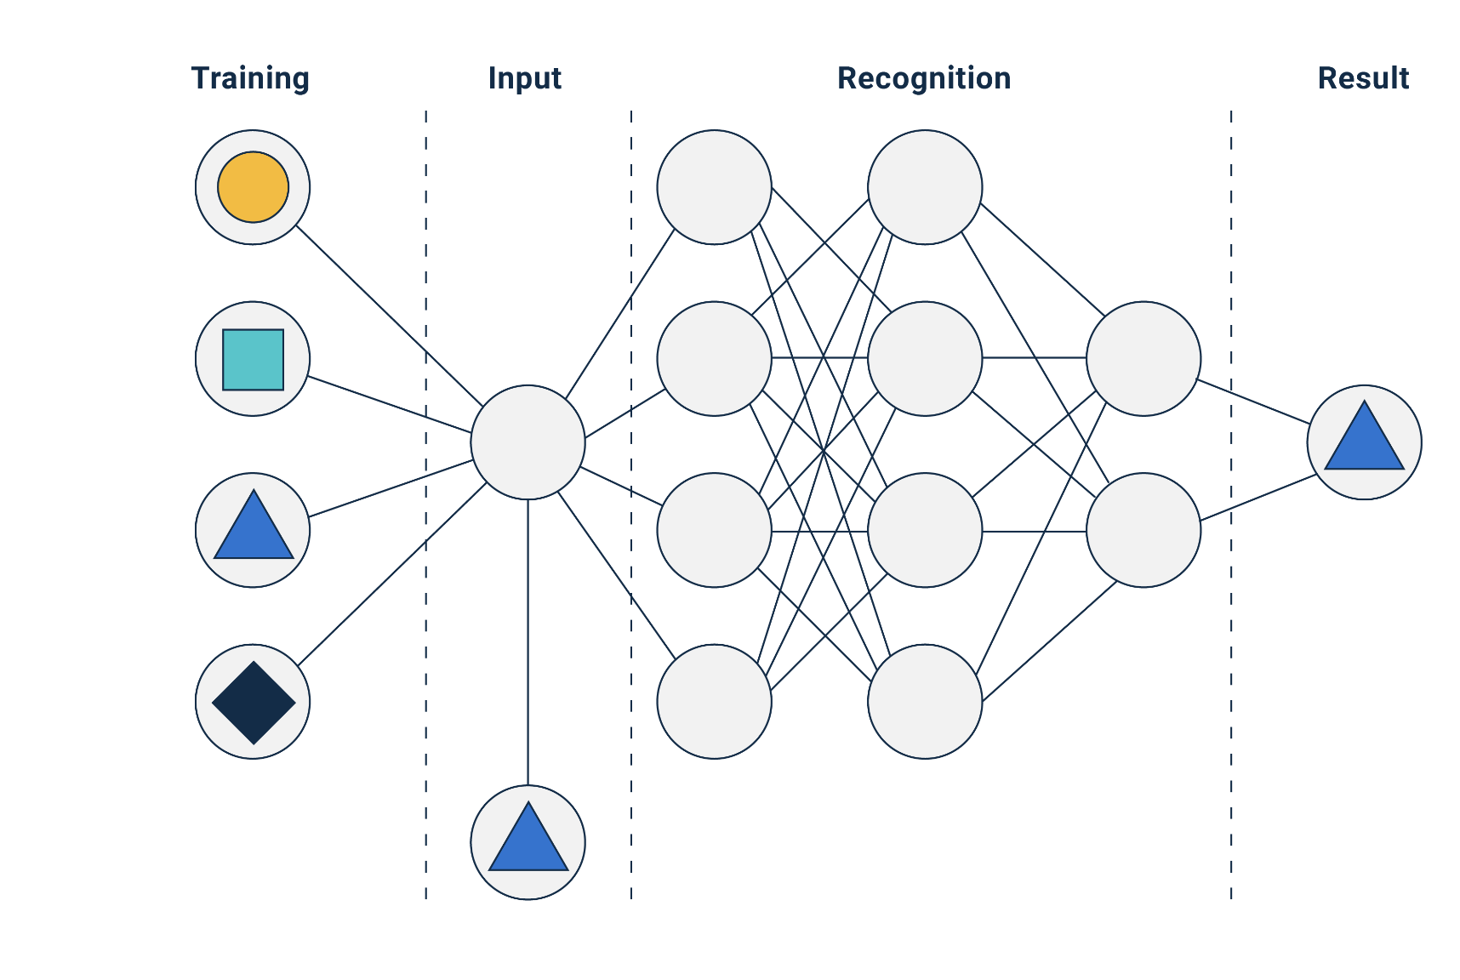
Neural Networks

Slide 13
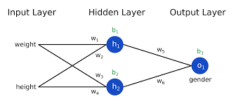
Neural Networks

Slide 14

Neural Networks vs. Traditional Machine Learning Models
Advantages
Disadvantages
Effectively detect complex relationships within data
Predict consumer behavior
Likelihood of default
Greater tolerance for “messy” data
Too complex for humans to understand
The “black box” problem
Prone to overfitting

Slide 15
Deep learning is a type of neural network that consists of three or more layers. These additional layers help to make the algorithm even more efficient and accurate than a traditional neural network.

Slide 16
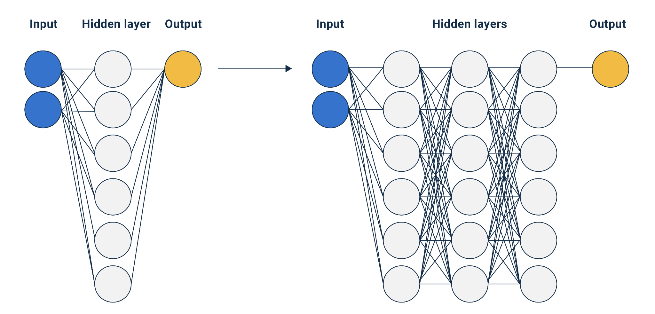
Deep Learning

Slide 17
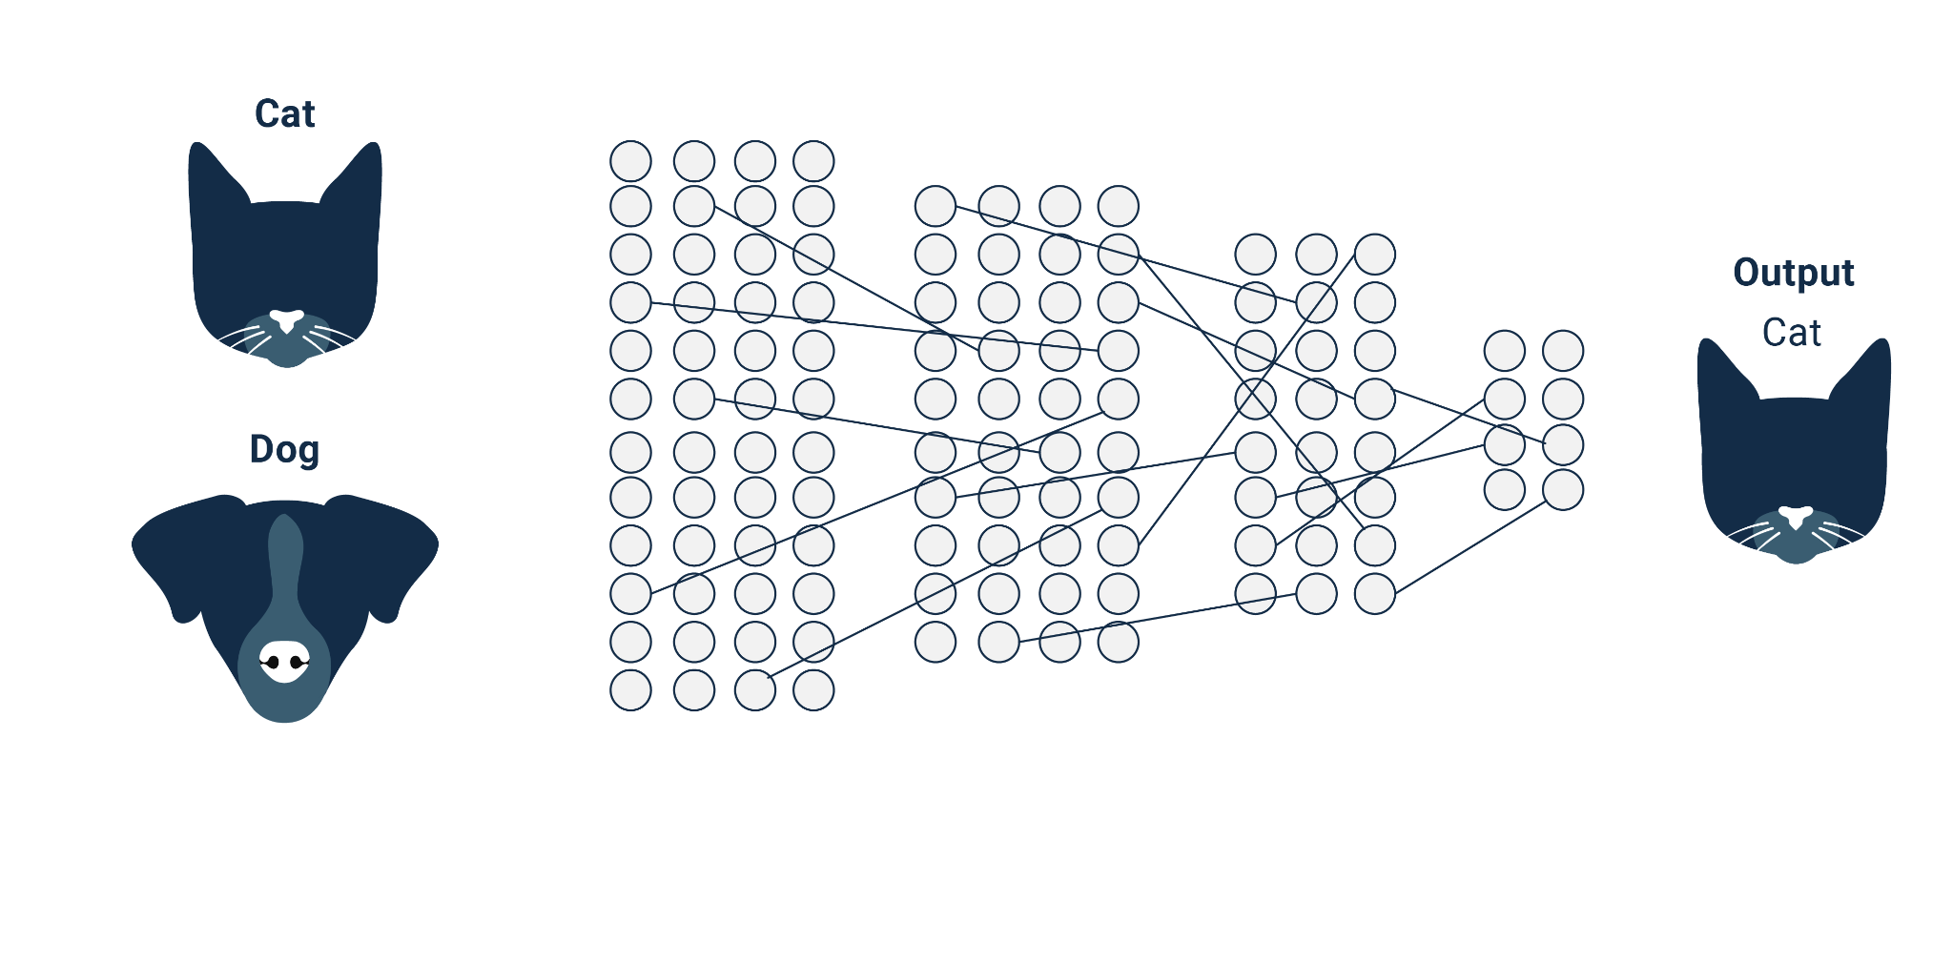
Example: Neural Network

Slide 18
Natural language processing (or NLP) combines the rules of human linguistics with ML algorithms not only to translate text into a format that a computer can understand, but to essentially understand the meaning behind the words, including the writer or speaker’s intent and sentiment.

Slide 19
A large language model is a type of “deep learning algorithm that can recognize, summarize, translate, predict and generate text and other forms of content based on knowledge gained from massive datasets.”
— Lee, A. 2023. What are large language models used for? [Blog, 26 January].
Available: https://blogs.nvidia.com/blog/2023/01/26/what-are-large-language-models-used-for/ [2023, April 6].

Slide 20
“A transformer model is a neural network that learns context and thus meaning by tracking relationships in sequential data like the words in this sentence.”
— Merritt, R. 2022. What is a transformer model? [Blog, 25 March].
Available: https://blogs.nvidia.com/blog/2022/03/25/what-is-a-transformer-model/ [2023, April 5].

Slide 21
Transformer Model Process
1
Text or spoken words are fed into the algorithm which extracts the data and breaks each element into individual words or phrases through a process called tokenization.
2
The algorithm classifies and labels each element.
3
Using statistical training, the algorithm proposes the most likely meaning of the data.

Slide 22
Applications of NLP Models
Distinguishing spam from legitimate emails
Translating from one language to another
Social media sentiment analysis
Chatbots and virtual agents

Slide 23
Instructor Demonstration
Machine Learning is Awesome
Notes:
Learning Outcomes:
Understand the concept of pseudocoding
Source Material:
Coding prework: adapt content from Practice Computational Thinking section - some of this should be presented in a slideshow, and some of it could be presented by the instructor in VS Code.
Additional details:
The pseudocode provided in the source material uses JavaScript commenting style (double slashes //); we’re using Python for this course so the commenting style should use # instead.

Slide 24
Instructor Demonstration
AI Foundations
Notes:
Learning Outcomes:
Understand the concept of pseudocoding
Source Material:
Coding prework: adapt content from Practice Computational Thinking section - some of this should be presented in a slideshow, and some of it could be presented by the instructor in VS Code.
Additional details:
The pseudocode provided in the source material uses JavaScript commenting style (double slashes //); we’re using Python for this course so the commenting style should use # instead.

Slide 25
AI Foundations
Today’s AI Foundations section will cover GitHub, the industry-standard collaboration tool.
1
You will use GitHub to store your code, collaborate with your peers on projects, and submit assignments.
2
Your first Challenge assignment will be creating a repo with GitHub.
3
Getting comfortable with Git and GitHub is critical for your success in the boot camp and post-graduation. Invest the time now to get to know it well.

Slide 26
Instructor Demonstration
Intro to Git
Notes:
Learning Outcomes:
Understand the concept of pseudocoding
Source Material:
Coding prework: adapt content from Practice Computational Thinking section - some of this should be presented in a slideshow, and some of it could be presented by the instructor in VS Code.
Additional details:
The pseudocode provided in the source material uses JavaScript commenting style (double slashes //); we’re using Python for this course so the commenting style should use # instead.

Slide 27


Intro to Git
Git is a way for us to keep track of our work over time. Whenever we get another piece of a project working, we can save the change with Git.
Check-ins over time
Version 1
Version 2
Version 3
Version 4
Version 5
A
A1
A1
A2
A2
B
B
B
B1
B2
C
C1
C2
C2
C3

Slide 28
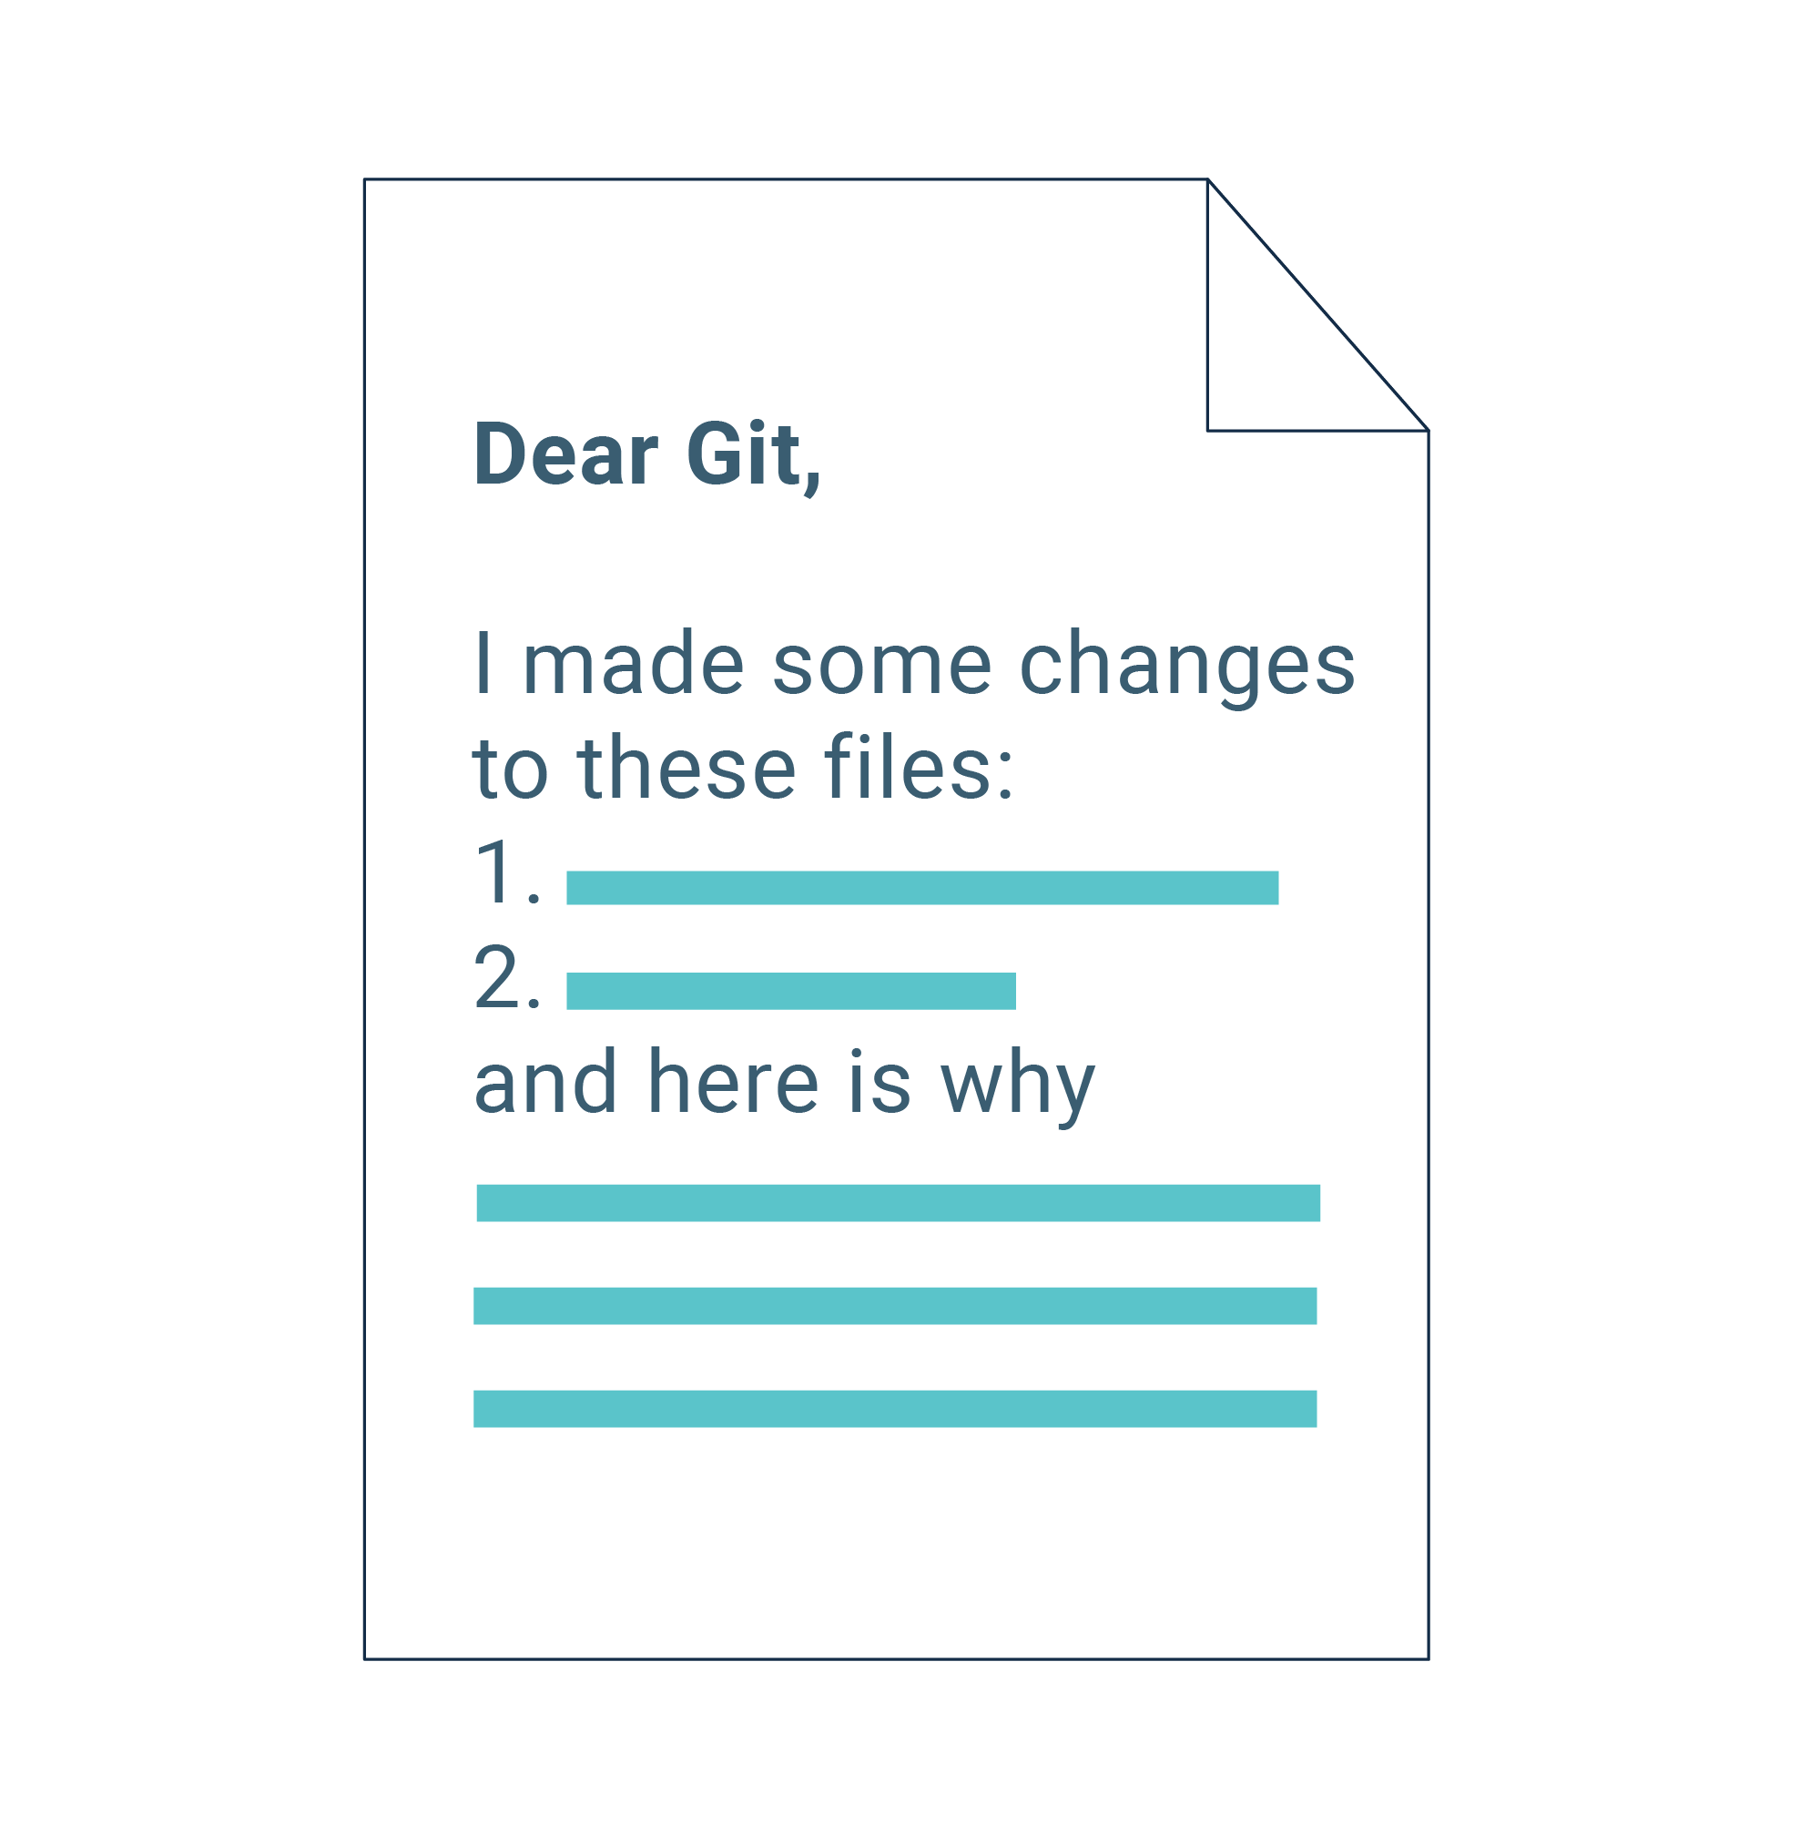

Slide 29
Git Commit
A Git “save” is called a commit. It represents a checkpoint for our project where we save and describe our work.
Initial commit
Master branch
Branch
If we break something while working on our code, this system allows us to restore working code from earlier. Since Git remembers these checkpoints, we can work on several different concerns all at once.
Notes:
https://git-scm.com

Slide 30





Git Version Control
Scenario: Your group has been working with Uber’s rider data, and you’ve decided to analyze the average age of the riders.
The root code for the project is called main.
Main
Version 1
Remote repository
The staging area is where you edit the files that will be part of the next commit.
Staging area
clone
This takes an existing GitHub repository, downloads it to the local computer, and links it to GitHub.
Notes:
https://git-scm.com

Slide 31

Git Version Control
Git essentially allows us to write this code and save it with the name age_analysis.
Main
Version 1
The staging area is the where you edit the files that will be part of the next commit.
Remote repository
Staging area
Main
Version 2
git commit
Your staged changes are saved once you commit.
age_analysis
Working directory
Notes:
https://git-scm.com

Slide 32

Git Version Control
age_analysis is a branch that originates from the main branch. It contains updates that will be added to the main branch when it’s ready to merge.
Version 1
Version 2
The staging area is the where you edit the files that will be part of the next commit.
Remote repository
age_analysis
Staging area
Main
Version 2
age_analysis
Working directory
Notes:
https://git-scm.com

Slide 33
Popular Git Commands
git clone | Clones a Git repository onto the local file system
git add | Adds changed files to the queue of tracked files ready to be committed
git commit | Adds tracked files as a bulk checkpoint ready to be pushed to the remote Git repository
git push | Uploads changed files from the local Git repository to the remote Git repository and updates the remote files
git pull | Downloads changed files from the remote Git repository to the local Git repository and updates the local files

Slide 34
Instructor Demonstration
Branching
Notes:
Learning Outcomes:
Understand the concept of pseudocoding
Source Material:
Coding prework: adapt content from Practice Computational Thinking section - some of this should be presented in a slideshow, and some of it could be presented by the instructor in VS Code.
Additional details:
The pseudocode provided in the source material uses JavaScript commenting style (double slashes //); we’re using Python for this course so the commenting style should use # instead.

Slide 35
Git Branching
1
Every Git repo starts off with a main branch, which is there to hold the production version of the repo’s code. But when we want to work on the code, we start by creating a new feature branch off the main.
2
If we create a new branch from the main, we essentially create a self-contained copy of all of the main branch code for us to work in.
3
When we’re satisfied with our work in the new feature branch, we submit a pull request from the feature branch to the main branch.
4
A pull request is a request to merge the diffs or changes from the source branch (the feature branch) to the target branch (main).

Slide 36
Git Branching
5
With the way our repos are set up now, another group member must look at and approve the pull request before its changes can be merged into the main.
6
Once a feature branch has been merged into the main, we delete it and then check back out to the main branch. From there, we’d check back out to a new feature branch, and repeat the process for each feature we add.

Slide 37
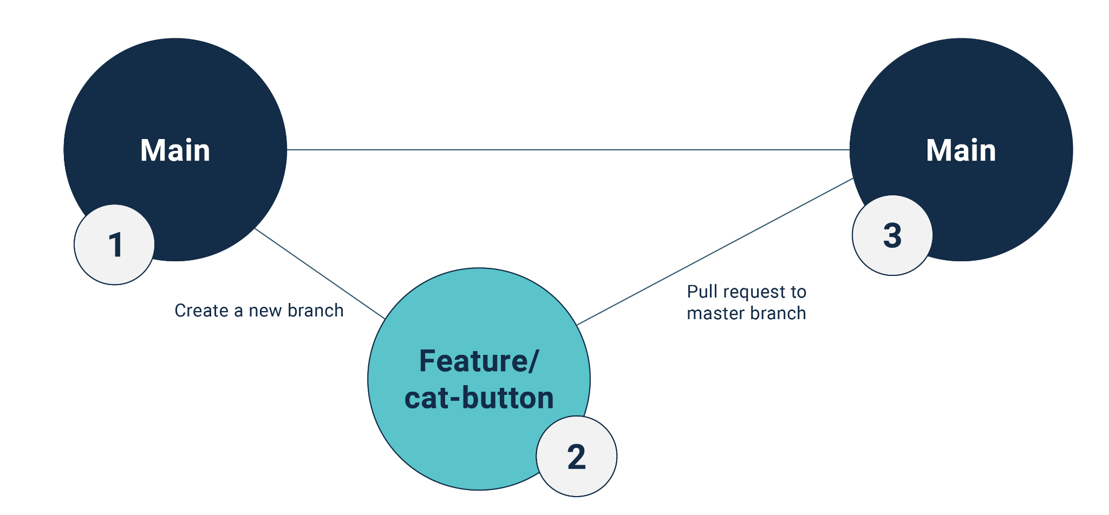
Git Branching

Slide 38
Git Branching, Pushing
In this activity, you will create branches, submit pull requests, and perform code reviews before merging.
15 Minutes

Slide 39

Time’s up!
Let’s review

Slide 40


Questions?

Slide 41

Let’s recap

Slide 42
Recap
After today’s lesson you are able to:
1
Compare and contrast supervised and unsupervised learning.
2
Define complex AI models including neural networks, deep learning, natural language processing, and transformers.
3
Download and upload files to GitHub using the git GUI.
4
Add, commit, and push code to GitHub from the command line.

Slide 43
Next
In the next lesson, you’ll engage in a series of activities, from brainstorming about your personal interactions with AI to investigating its transformative effects across diverse sectors. You’ll also get your hands on practical AI tools like Anaconda, the command line, and GitHub.

Slide 44

The End

